Slide 1
Machine Learning for Newsrooms
Jonathan Soma
Columbia University
js4571@columbia.edu
@dangerscarf
https://bit.ly/djc-2022-ml

Slide 2
Machine learning: what and why?
https://bit.ly/djc-2022-ml

Slide 3
What is M.L.?
Machine learning
Artificial intelligence
Fancy statistics
Not-so-fancy statistics
Almost everything!

Slide 4
Two use cases
ML for Business
ML for Investigations
Conversion rates
Article summaries
Content creation/article generation
Uncovering unusual data points
Finding bias
Doing large amounts of work, relatively quickly and easier

Slide 5




How M.L. works
INPUT
MAGIC BOX OF
MACHINE
LEARNING!
OUTPUT

Slide 6

Investigate.ai

Slide 7
Be a journalist, not a statistician or data scientist

Slide 8





$7
+ tip
$12
+ tip
$15
+ tip

Slide 9
“Training” a “model”
$5
$14
$3
$12
$17
$12
$12
$20
$18
$42
$9

Slide 10
What is a “model”?
INPUT
MAGIC BOX OF
MACHINE
LEARNING!
OUTPUT

Slide 11
It’s not the tool, it’s how you use it.

Slide 12
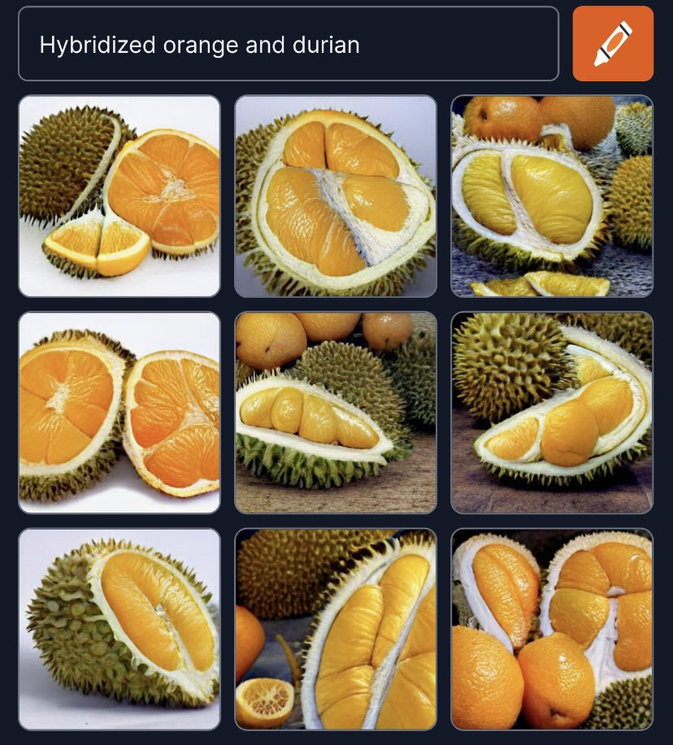
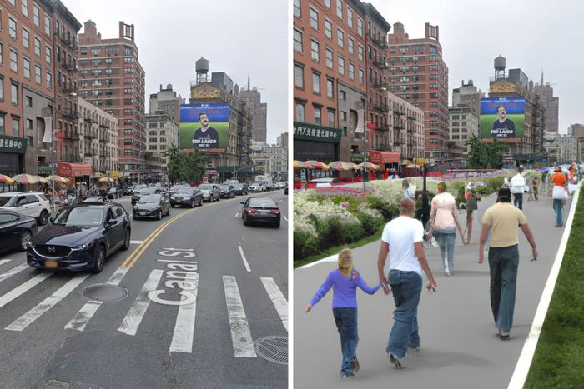
DALL-E, midjourney

Slide 13
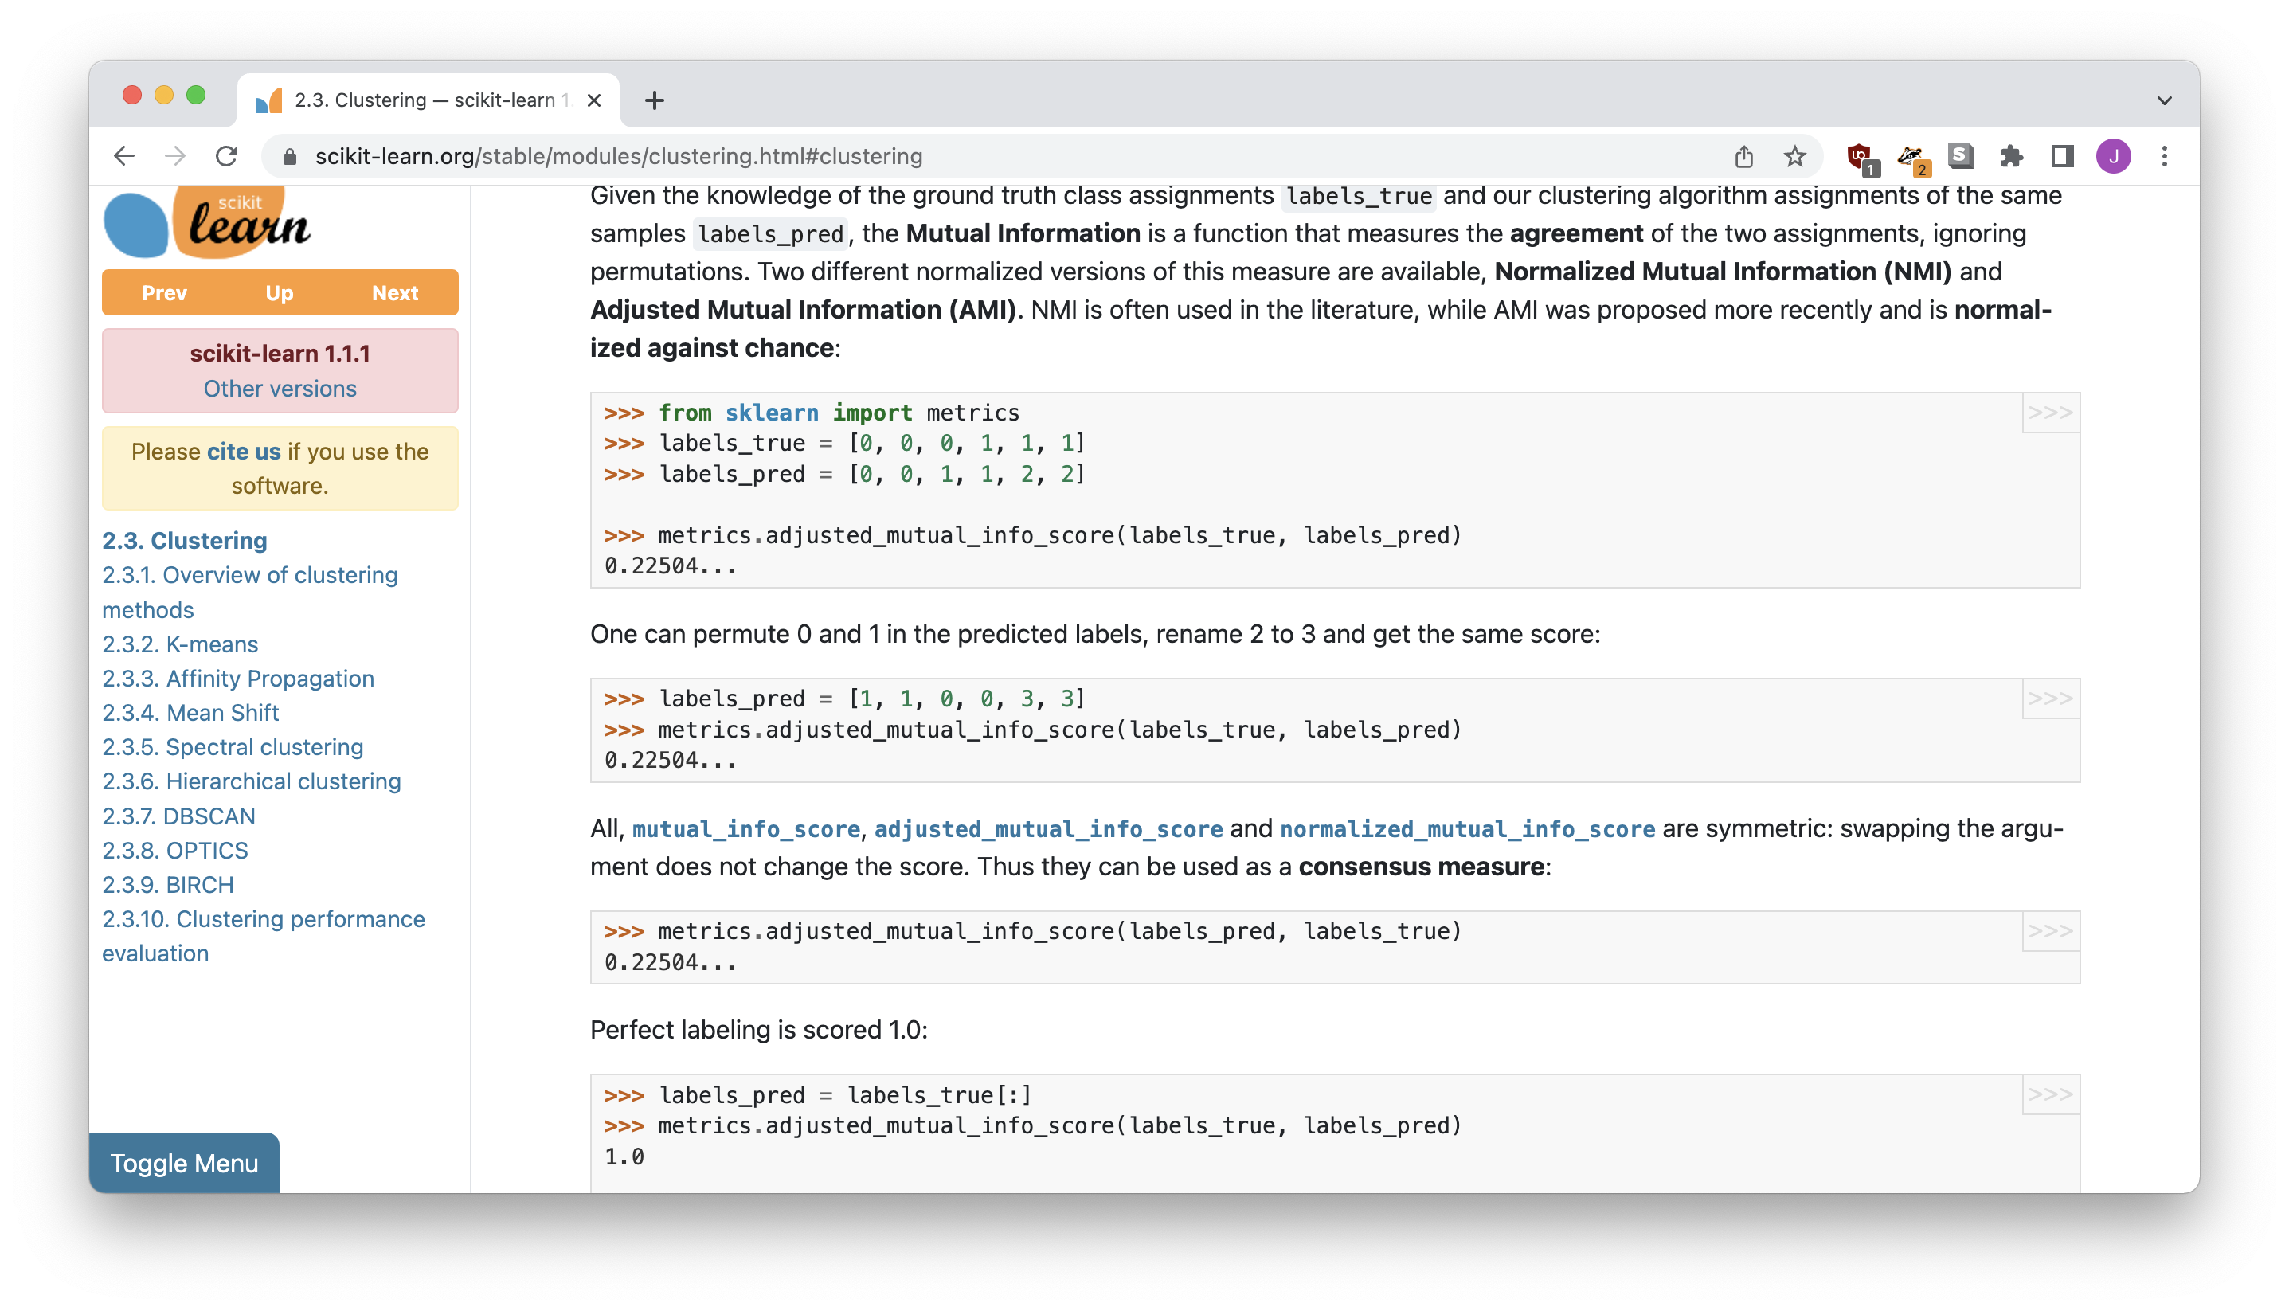
sklearn, tensorflow

Slide 14
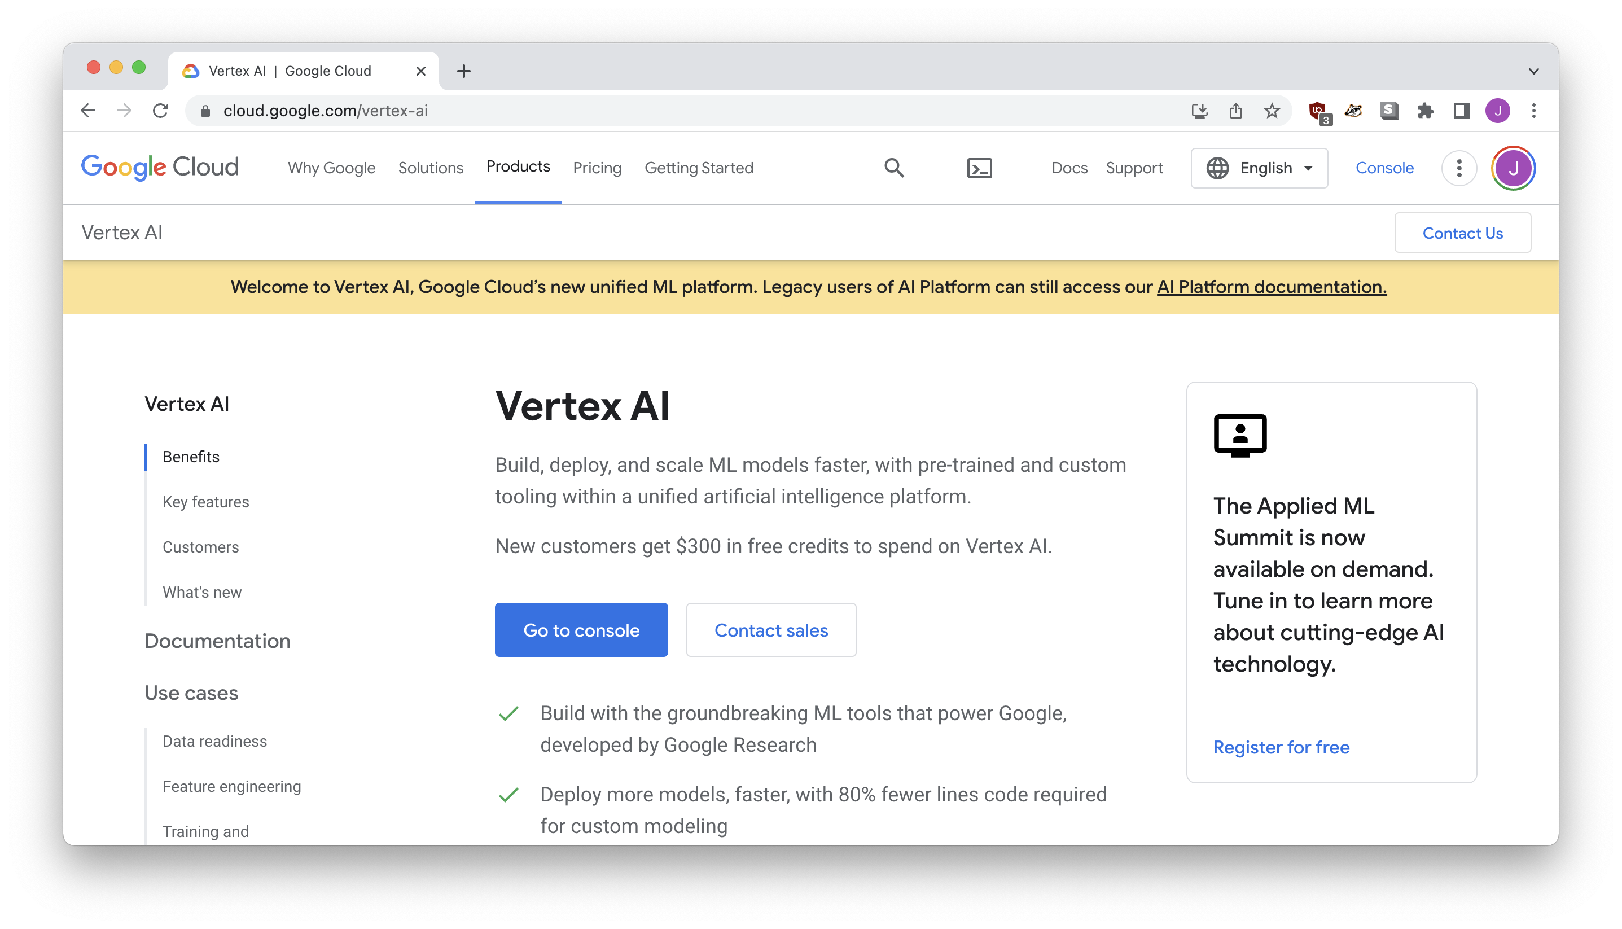
Refinery, VERTEX AI, etc…

Slide 15
Caution: The machine only reproduces what it’s seen.

Slide 16
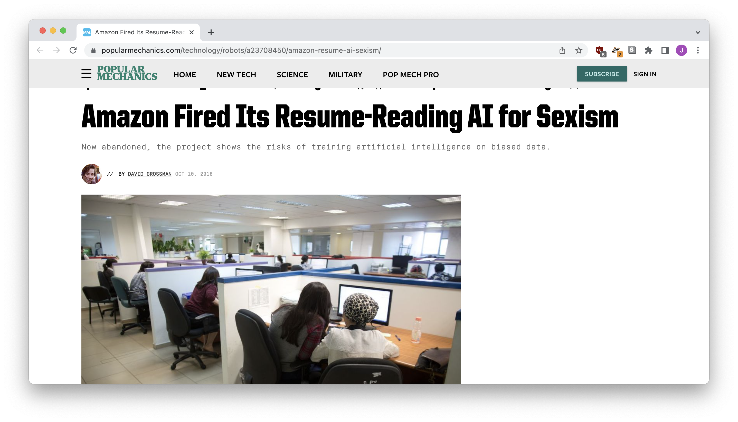
resume screener
Notes:
https://www.popularmechanics.com/technology/robots/a23708450/amazon-resume-ai-sexism/

Slide 17
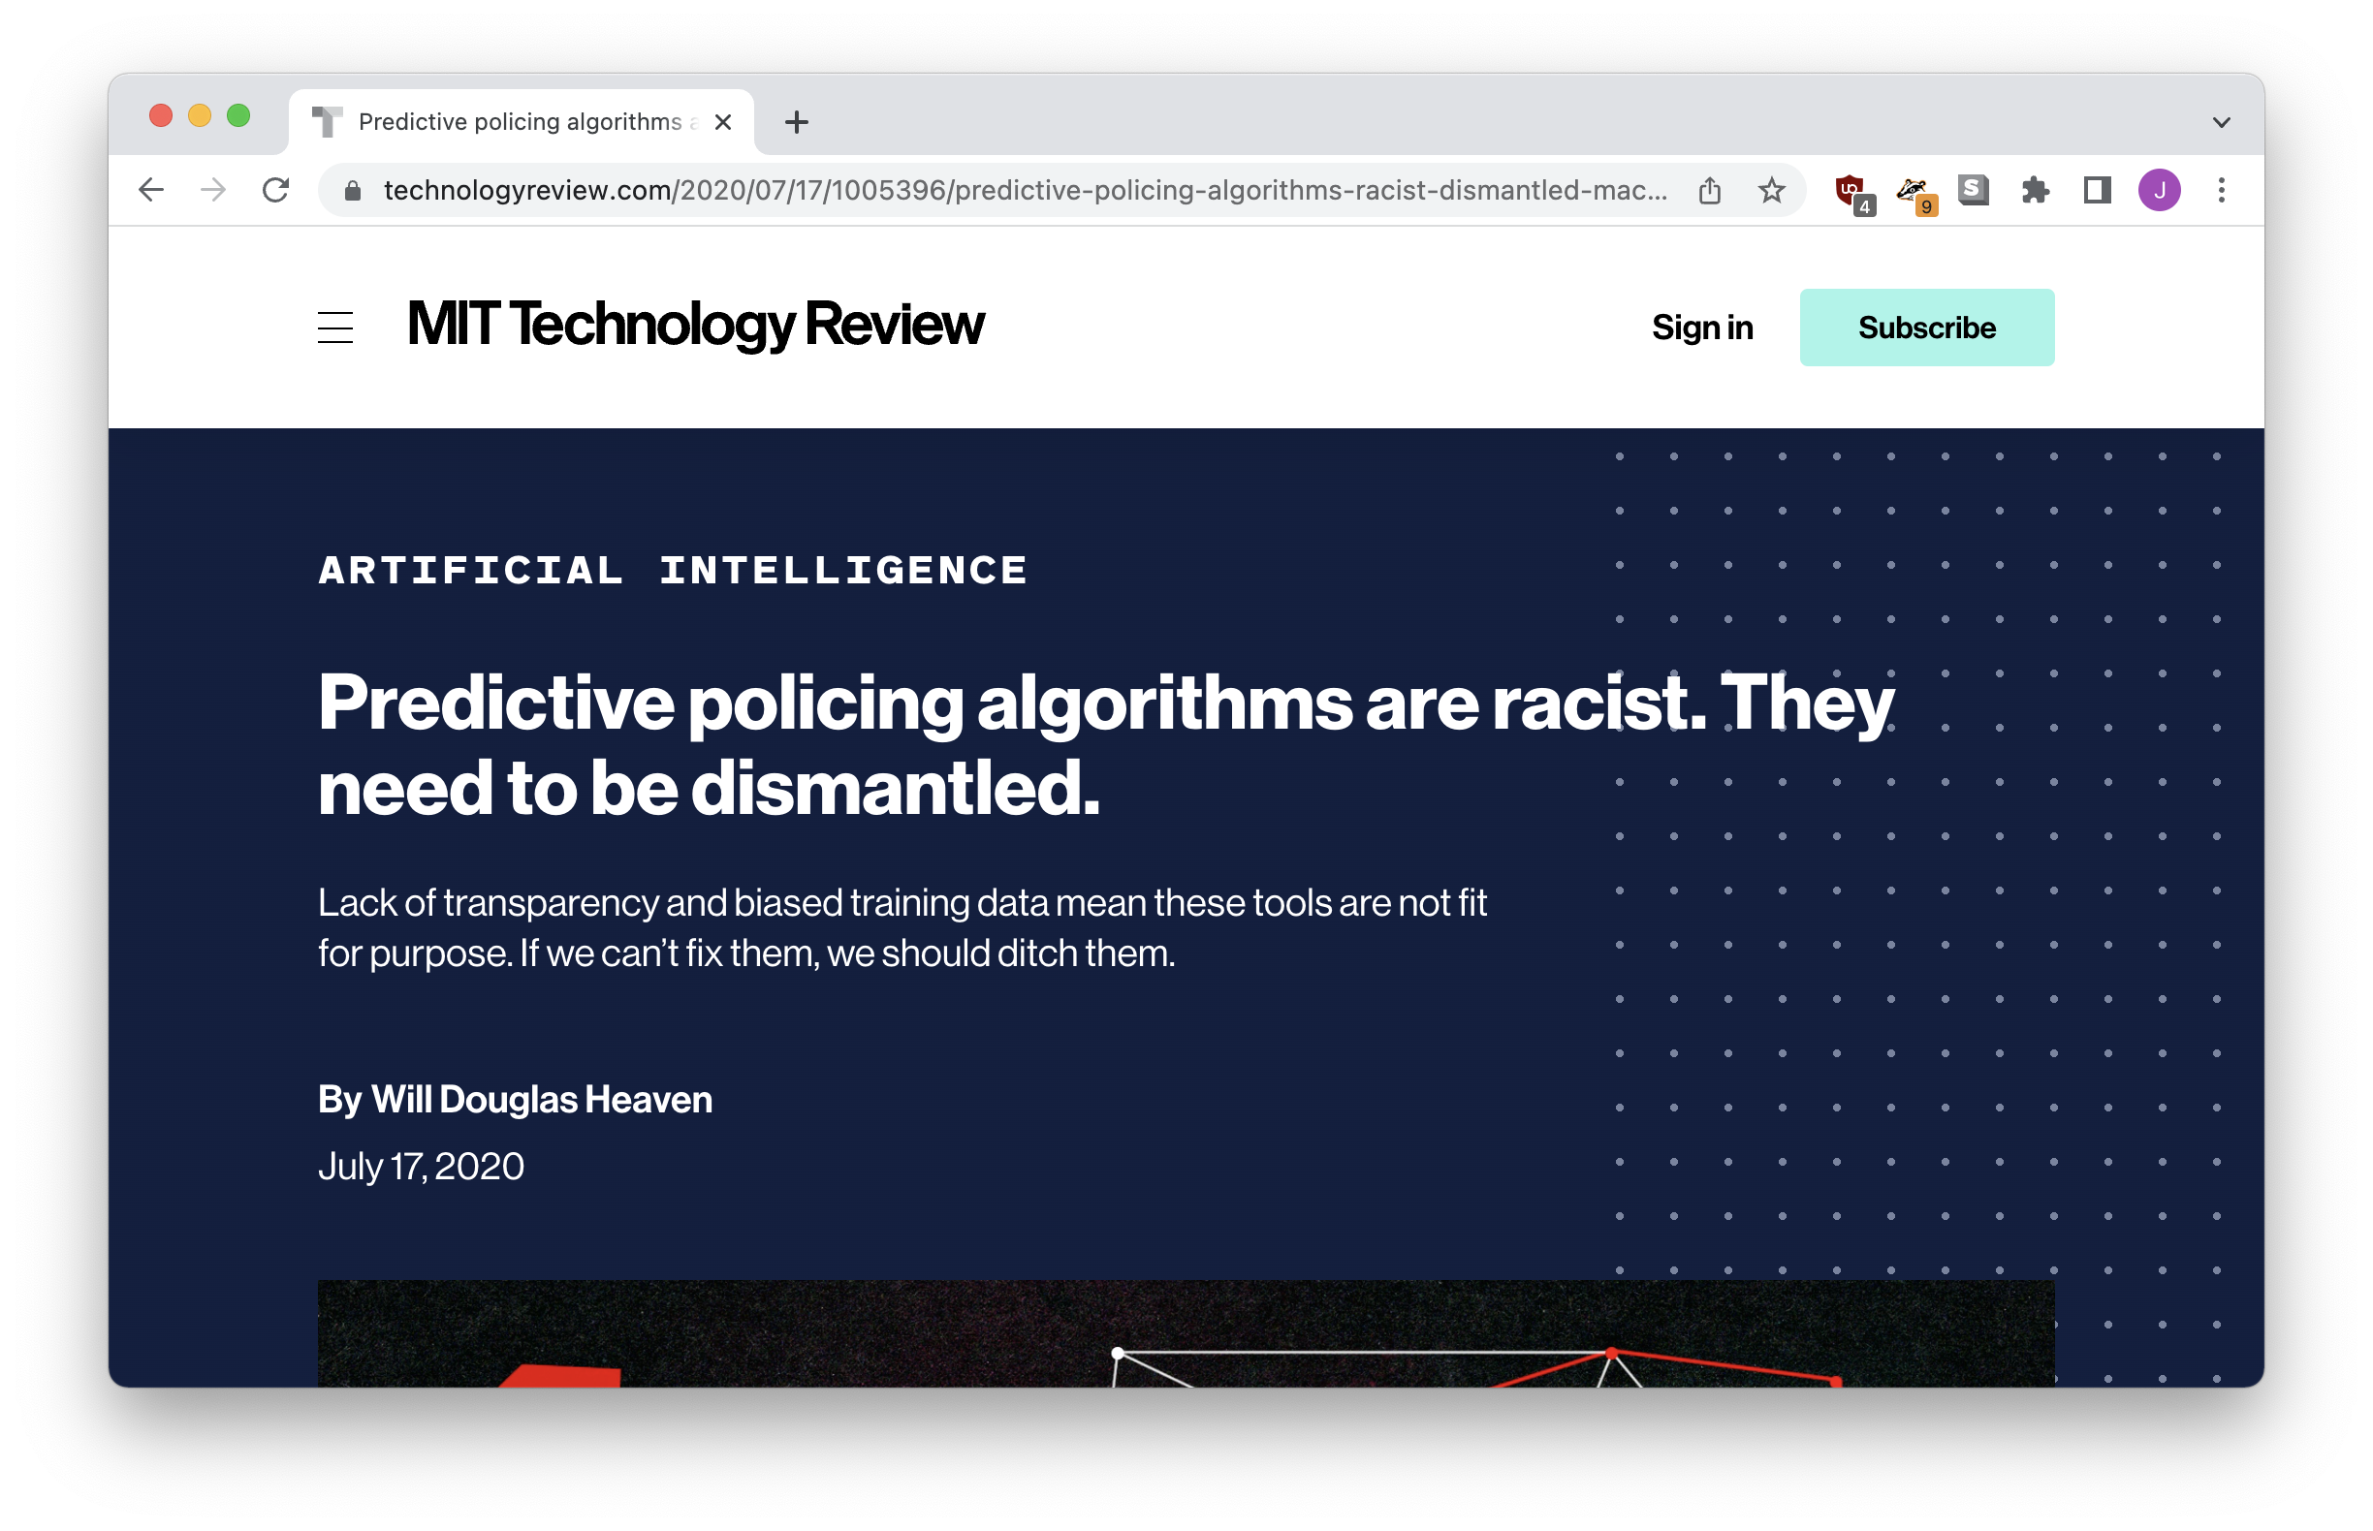
“Bias laundering”
Notes:
https://www.technologyreview.com/2020/07/17/1005396/predictive-policing-algorithms-racist-dismantled-machine-learning-bias-criminal-justice/

Slide 18
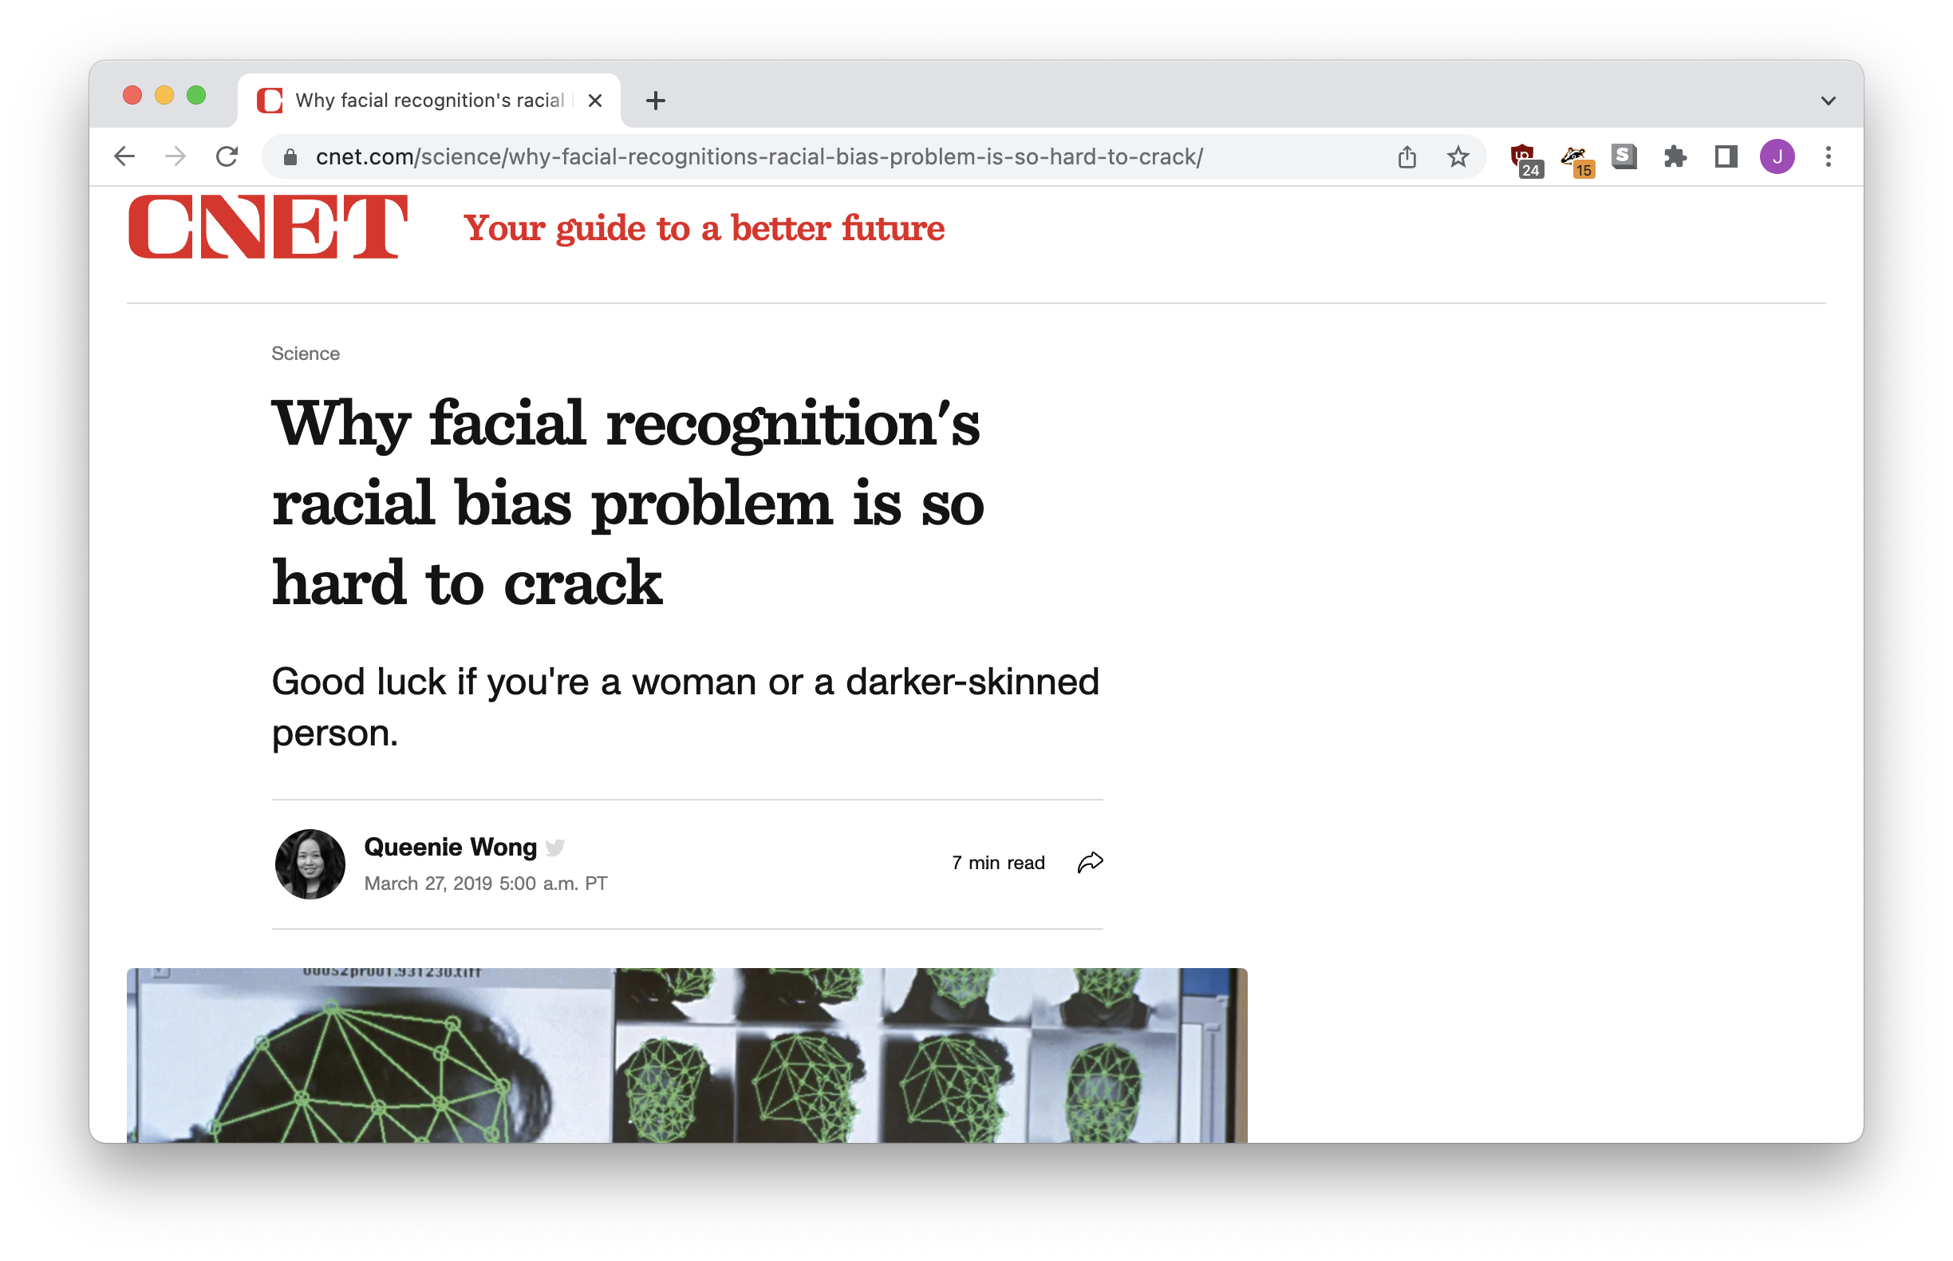
Is your data complete?

Slide 19
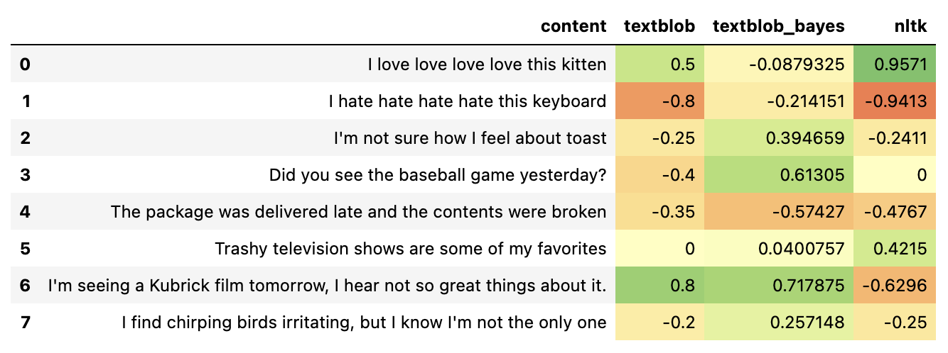
Where’s your data from?
Notes:
Textblob: Words in customer reviews
Textblob + Baytes: Words in movie reviews, rated by stars
NLTK: List of words, rated
https://investigate.ai/investigating-sentiment-analysis/comparing-sentiment-analysis-tools/

Slide 20

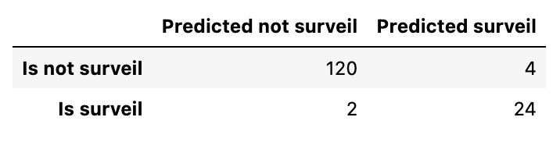
“Testing” your model
Notes:
Optimizing for metrics

Slide 21
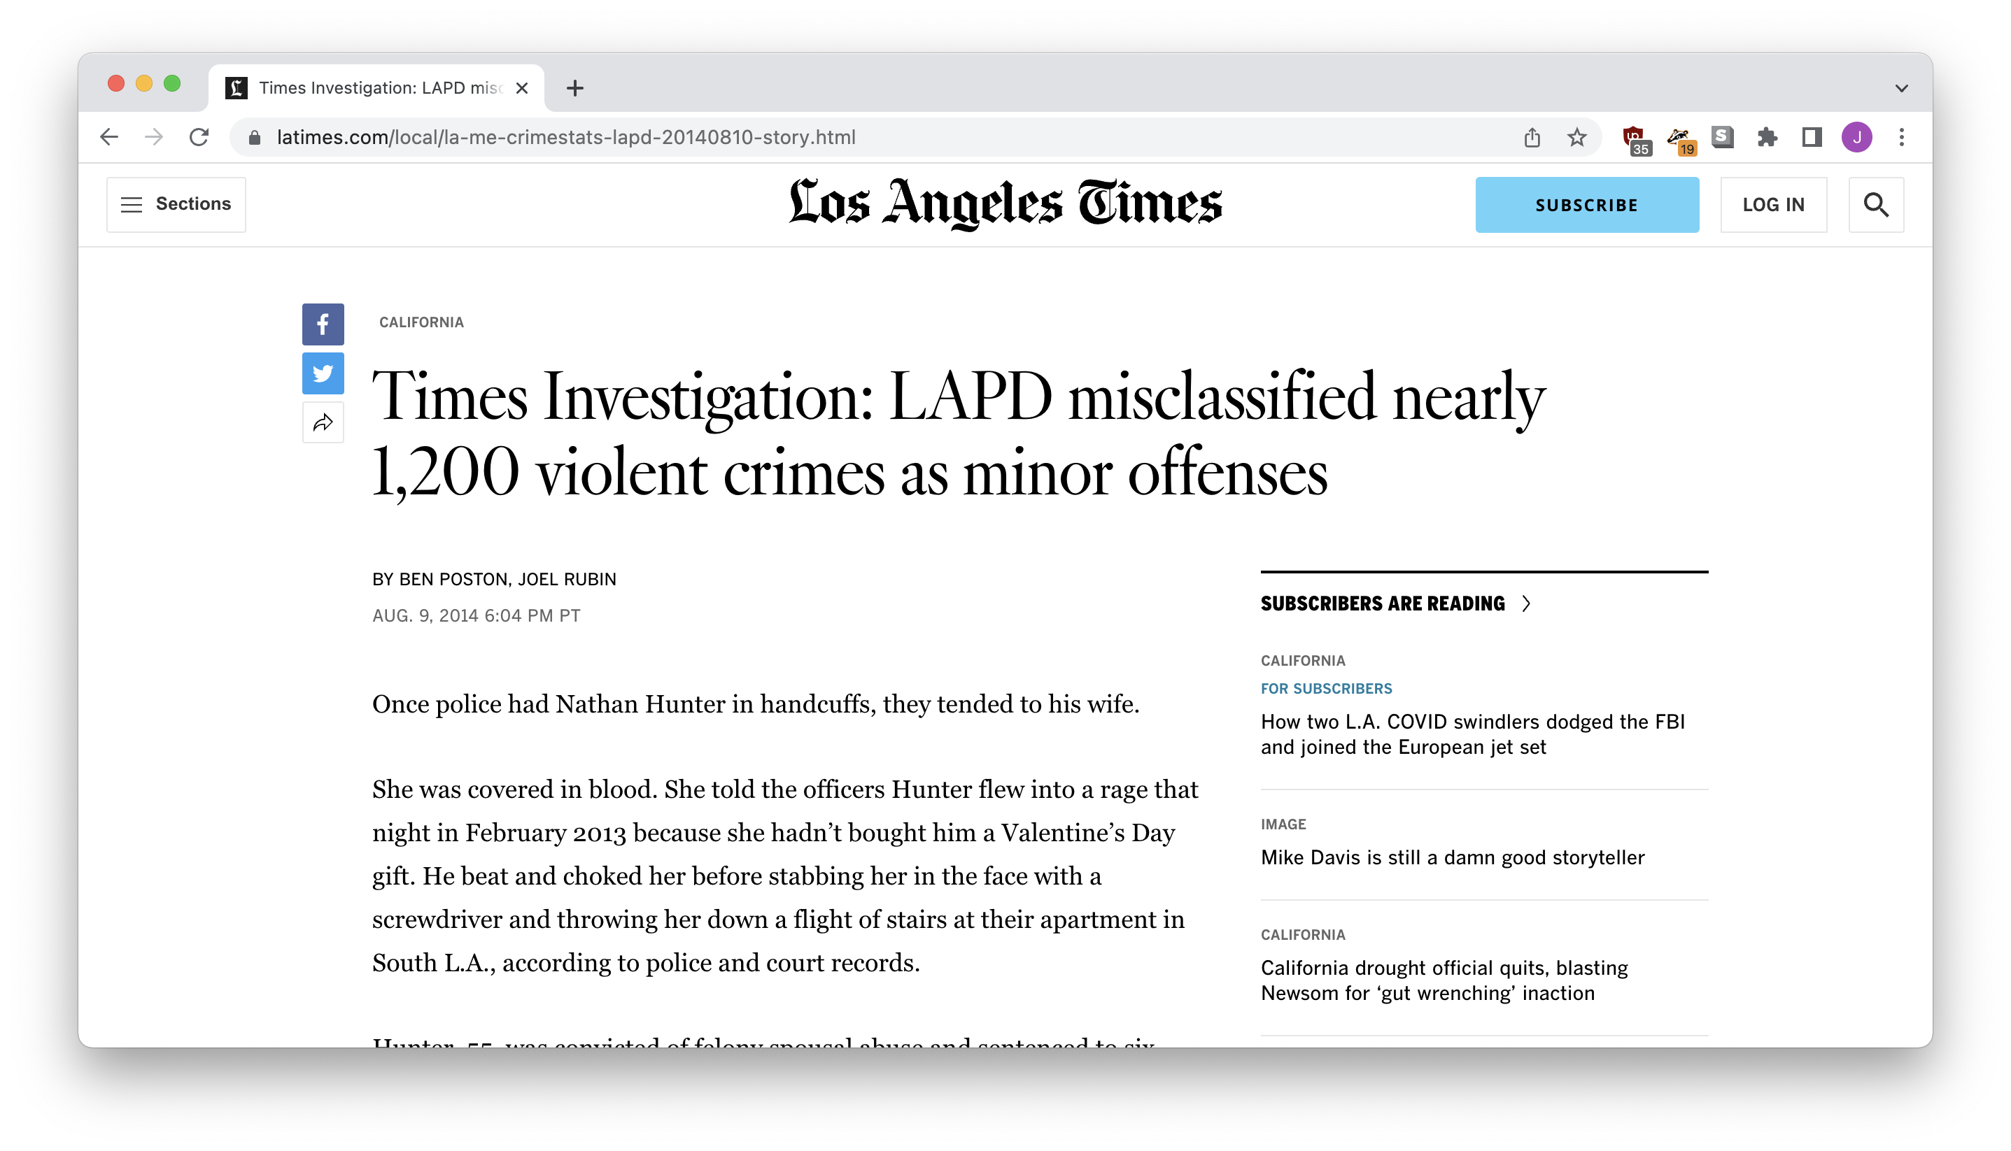
“Testing” your model
Notes:
Optimizing for metrics

Slide 22
Let’s produce some stories!

Slide 23
Finding unusual data
Does reality match what you’d expect?
Collect your data
Train your model
Make predictions: what outcomes don’t match?
Click for LINEAR REGRESSION

Slide 24
Finding bias
What really affects an outcome?
Find a situation where the outcome might be biased
Decide what might affect the outcome
Collect your data
Train your model
What inputs are most important to the outcome?
Click for LOGISTIC REGRESSION

Slide 25
Automating workflows
Tell the computer: “do what I just did, but faster”
Collect the data you’d like to organize or sort
Label some of the items
Train your model
Predict labels for the unlabeled data
Click for CLASSIFICATION

Slide 26
Machine Learning for Newsrooms
Jonathan Soma
Columbia University
js4571@columbia.edu
@dangerscarf
https://bit.ly/djc-2022-ml

